Slide 1


A LEVER TALENT WORKING SESSION
Meet Obi
Behavioral intelligence for the conversations that count.

Slide 2


THE MOMENTS THAT MATTER
Managers and employees care.
They just don't always have the words.
Feedback gets softened
Conversations get delayed
Tension increases exponentially
These are the moments that quietly drive turnover and performance dips.

Slide 3
WHY IT MATTERS
Equipped managers are the retention lever
Employees thinking about quitting in the next 12 months
63%
27%
vs
with a bad manager
with a good manager
Manager quality cuts quit-intent by more than half.
The Obi connection: PI’s behavioral insights in every manager’s hands — in the moment they manage, not once a year.
Notes:
https://www.businesswire.com/news/home/20210804005720/en/2000-Employees-Across-15-Industries-Reveal-Bad-Managers-and-Burnout-Are-Causing-Them-To-Quit-Joining-The-Great-Resignation-Hybrid-Work-Challenges-and-Poor-Communication-Are-also-Key-Factors

Slide 4
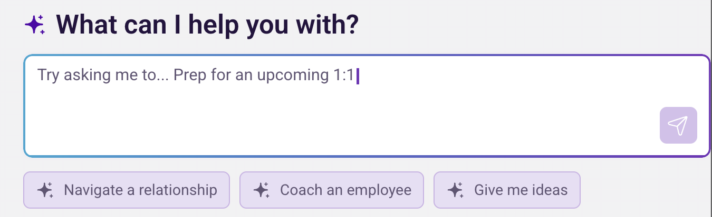
MEET OBI
Your team's strategic talent
partner, on demand.

Slide 5
HOW IT WORKS
A messy moment to the right words,
in about 30 seconds.
1
2
3
4
Describe the moment
→
Obi reads your org data
→
Get a playbook in seconds
→
Walk in ready
Reads behavior at the factor level, then advises in plain language.

Slide 6
WHAT MAKES IT DIFFERENT
Advice vs. behavioral intelligence.
Public AI tools
Obi
–
Generic advice
✓
Built on 70 years of PI science
–
Doesn't know your people
✓
Knows your real profiles
–
Your inputs can leave your walls
✓
Stays inside your PI account

Slide 7
BUILT TO BE TRUSTED
Private and secure by design.
Your chats are private
Respects every PI permission
◉
≡
Data never leaves your org
You decide, Obi informs
↑
✓
PI Obi FAQs

Slide 8
WHERE OBI HELPS
From strategy to the everyday.
Tough feedback
Coaching & motivation
1:1s & reviews
⚑
☆
⇄
Team friction
Team design & hiring
Admin & time-savers
⚔
◇
◷

Slide 9
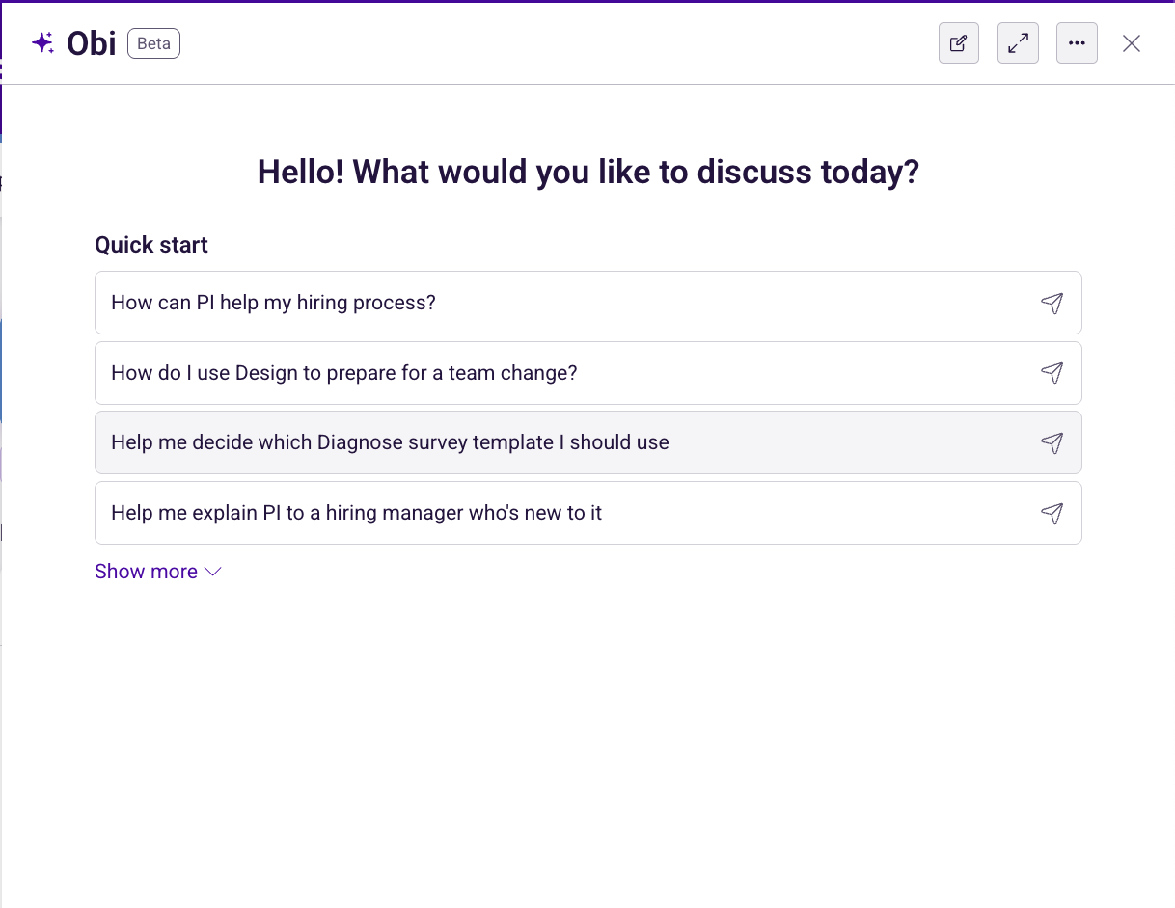
LIVE WALKTHROUGH
Let's open it up.
01
Tough feedback
02
Saying no, with respect
03
Easing team friction

Slide 10
OBI IN ACTION
DEMO 1
Tough feedback, without the flinch.
Watch for
TRY THIS PROMPT
✓
Opening shifts to the person
“@[name] has been missing deadlines and gets defensive. Based on their PI profile, build me a playbook: what to say, what to avoid, and how to handle pushback.”
✓
Exact phrases to use and avoid
✓
A plan for defensiveness

Slide 11
OBI IN ACTION
DEMO 2
Saying no, with respect.
Watch for
TRY THIS PROMPT
✓
Decision, reason, next step
“@[name] asked for time off I can't approve. Based on their PI profile, help me deliver it clearly and respectfully, then draft it as a message and a spoken version.”
✓
Ask it to warm the tone
✓
Email, chat, or a live script

Slide 12
OBI IN ACTION
DEMO 3
Easing team friction.
Watch for
TRY THIS PROMPT
✓
Where the two naturally clash
“Build a playbook to ease the growing friction between @[name] and @[name], using both PI profiles, plus management strategies to help.”
✓
Concrete steps, not a diagnosis
✓
Bonus: paste a meeting transcript

Slide 13
GETTING STARTED
You already have it.
1
2
3
4
Open Obi in PI
Set your org context
Pick the response style
Bring a real moment

Slide 14
GETTING STARTED
Open Obi in PI

Slide 15
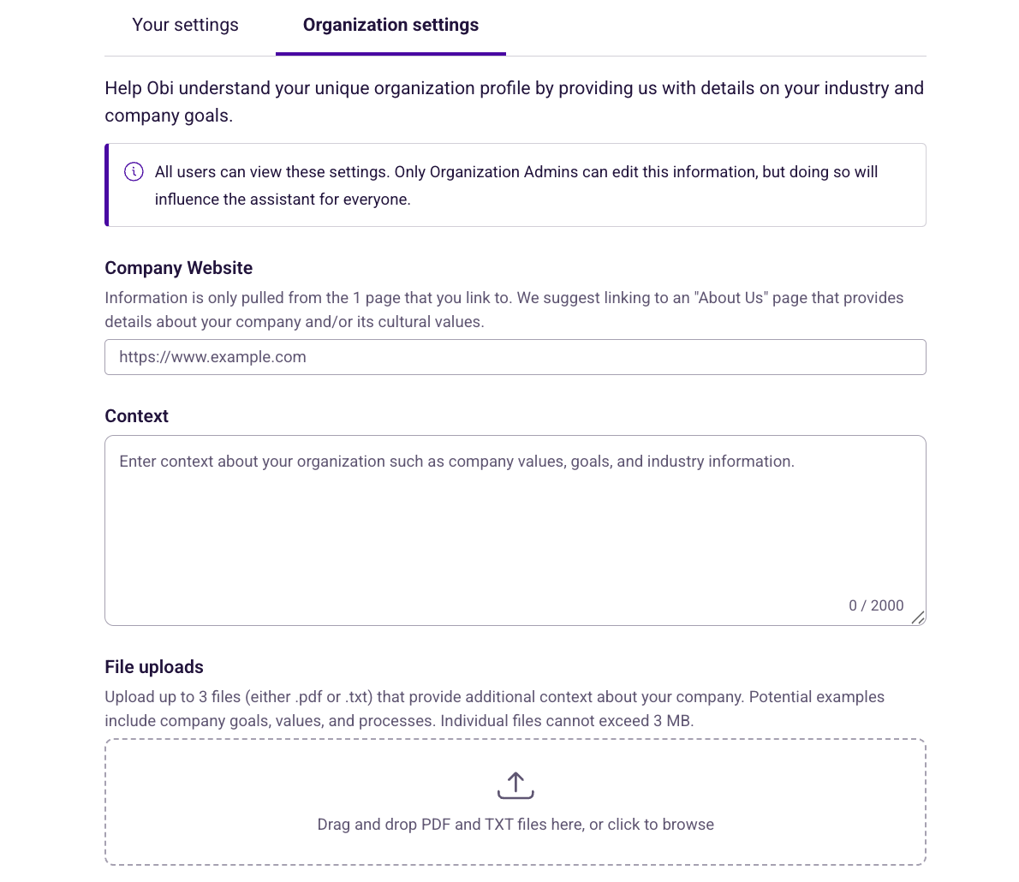
GETTING STARTED
Set your org context

Slide 16
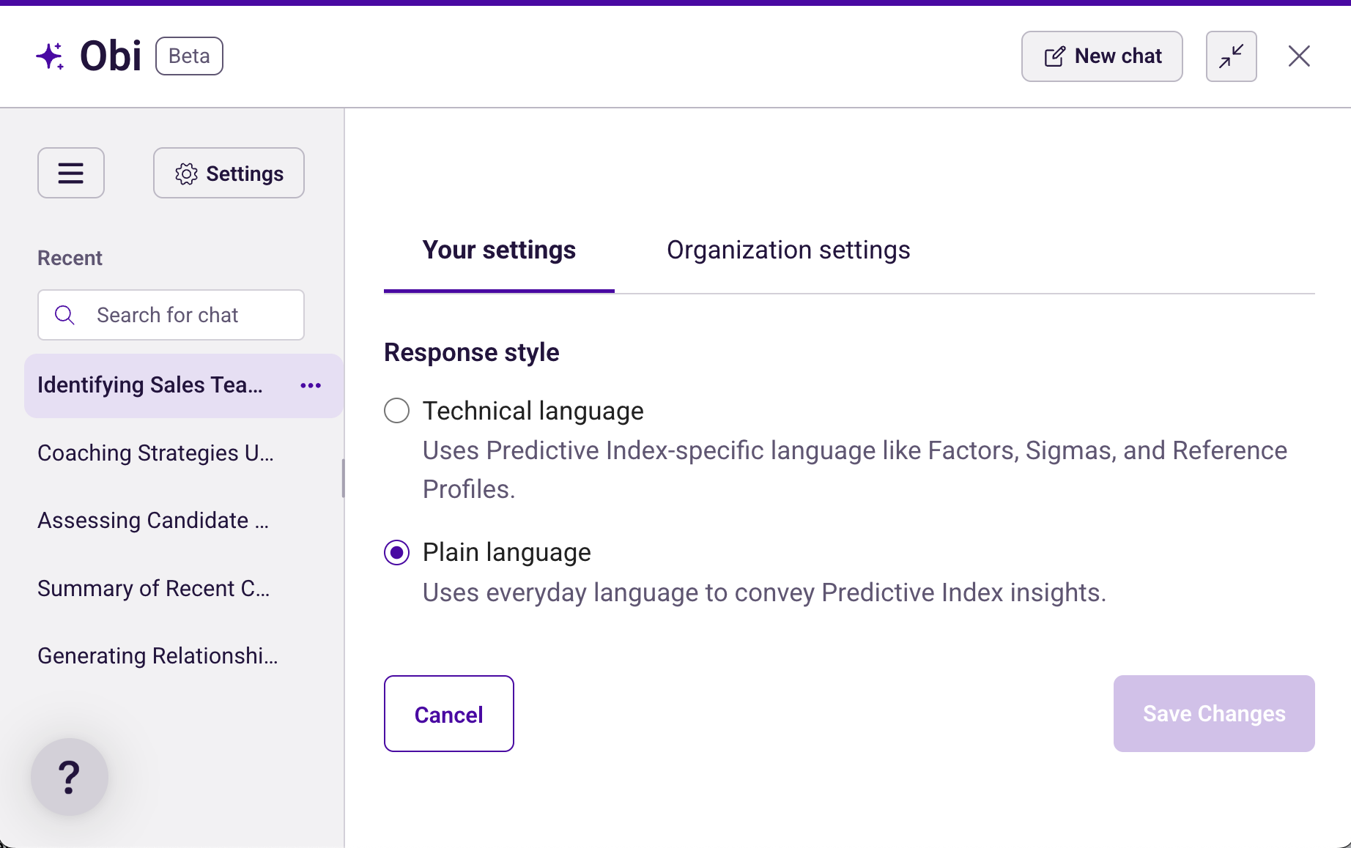
GETTING STARTED
Pick the response style

Slide 17
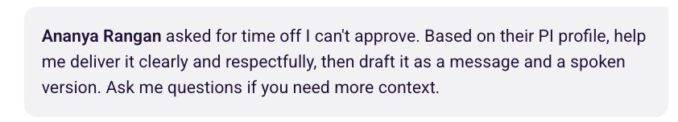
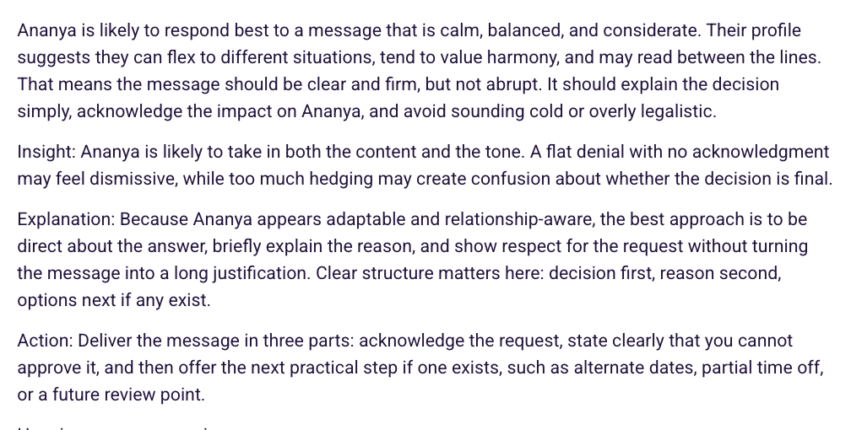
GETTING STARTED
Bring a real moment
:You
Obi:

Slide 18
GET SHARPER ANSWERS
Five ways to prompt better.
1
Name the people
2
Give it context
3
Specify the format
4
Push for the tone
5
When unsure, ask Obi

Slide 19
YOUR MOVE THIS WEEK
Go have a conversation that counts.
Open Obi
Bring it one real moment before Friday
Try a prompt
Try any of the quick prompts
Ask Us
We'll help you process any situation
Questions? Lever Talent is your partner for all things talent strategy, including AI-Fluency in the workforce.

